Slide 1
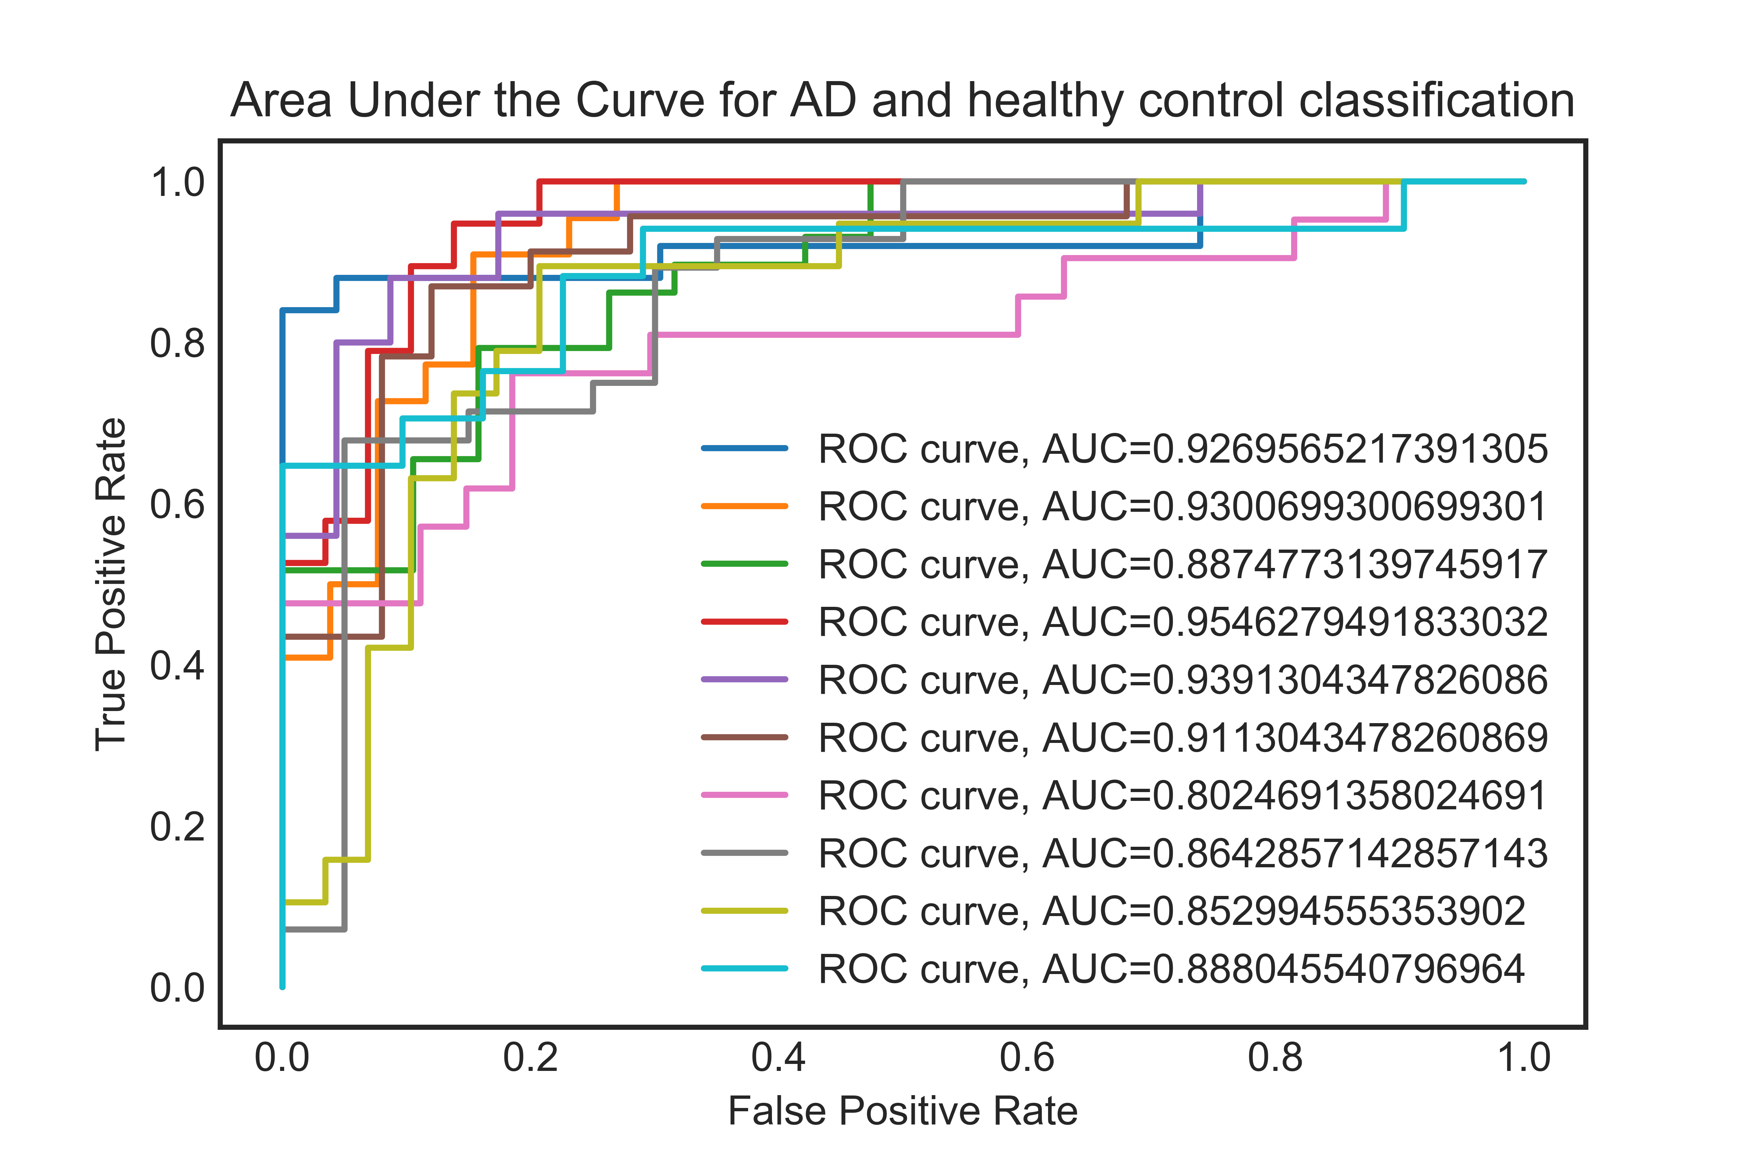
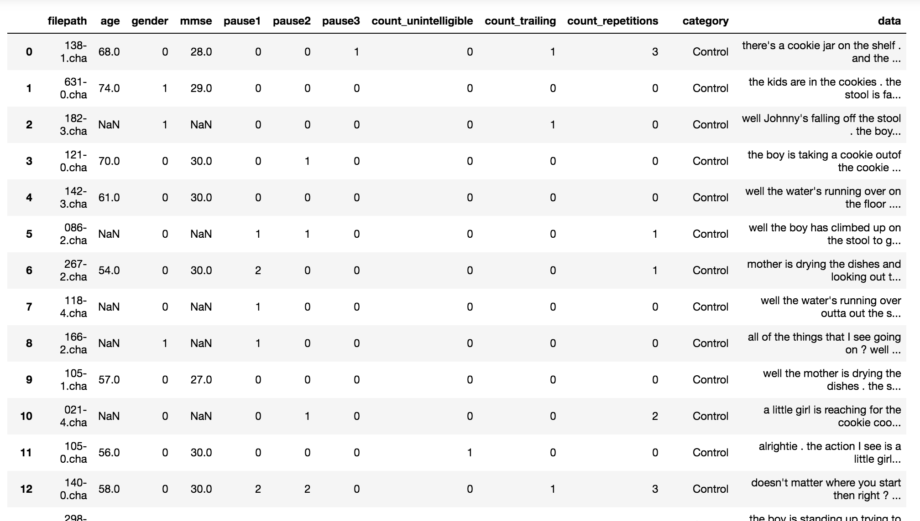
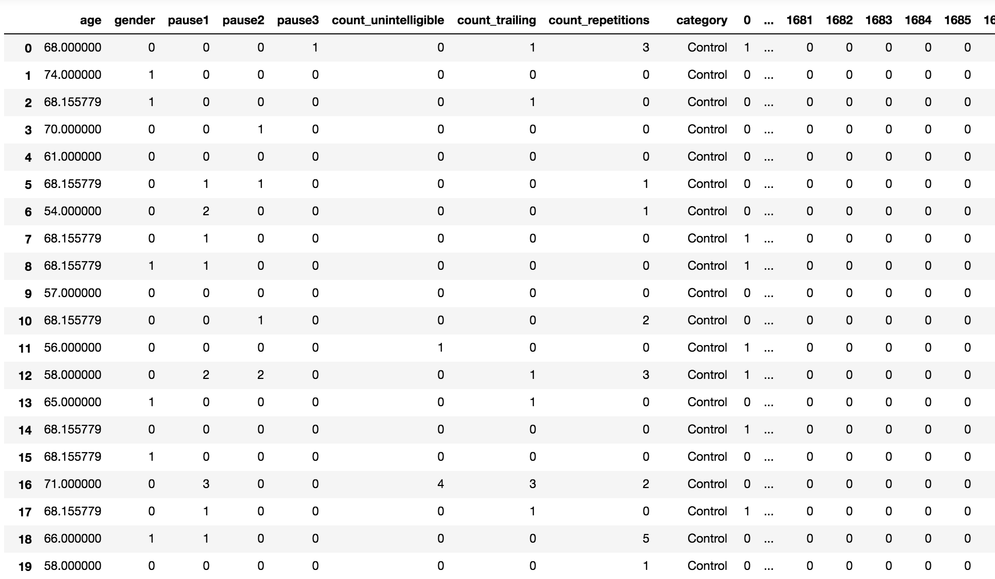
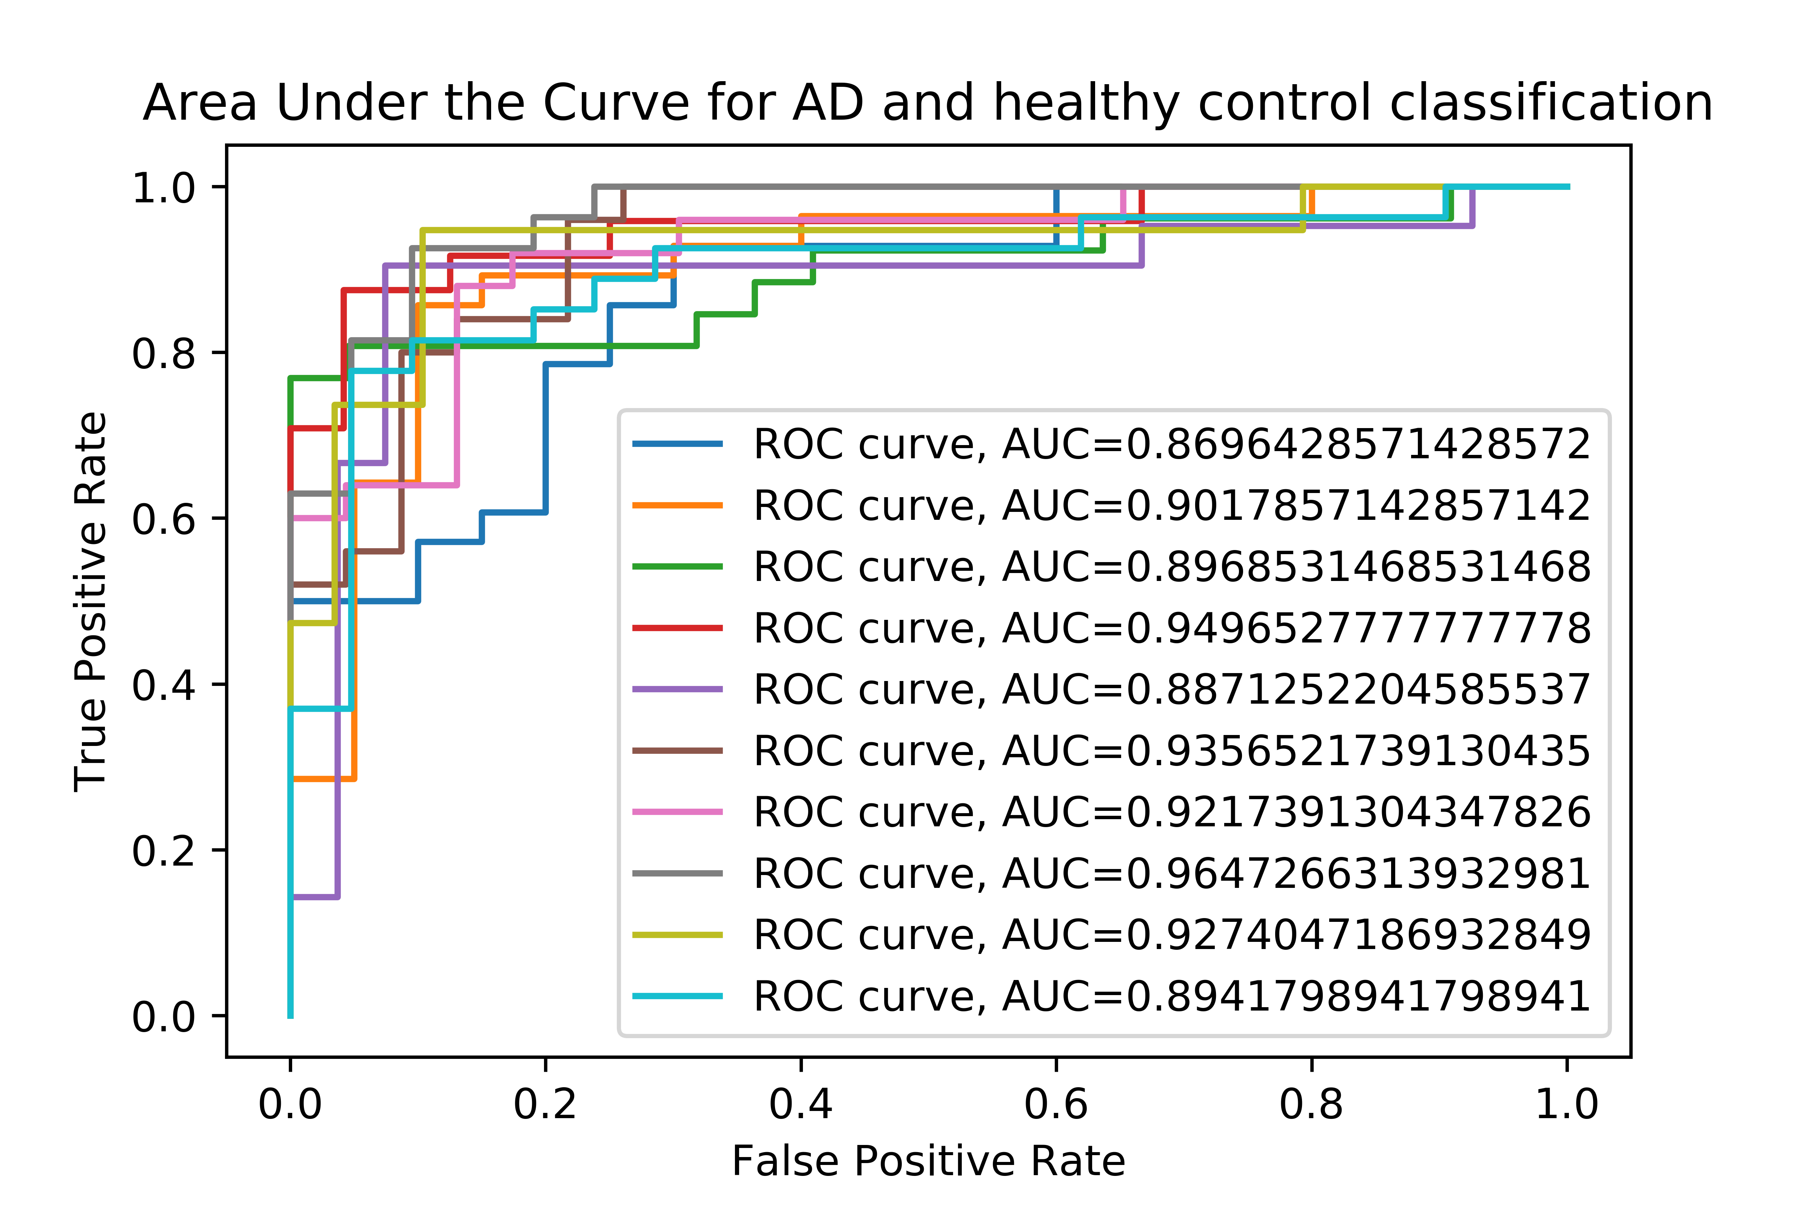
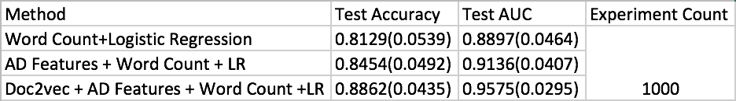
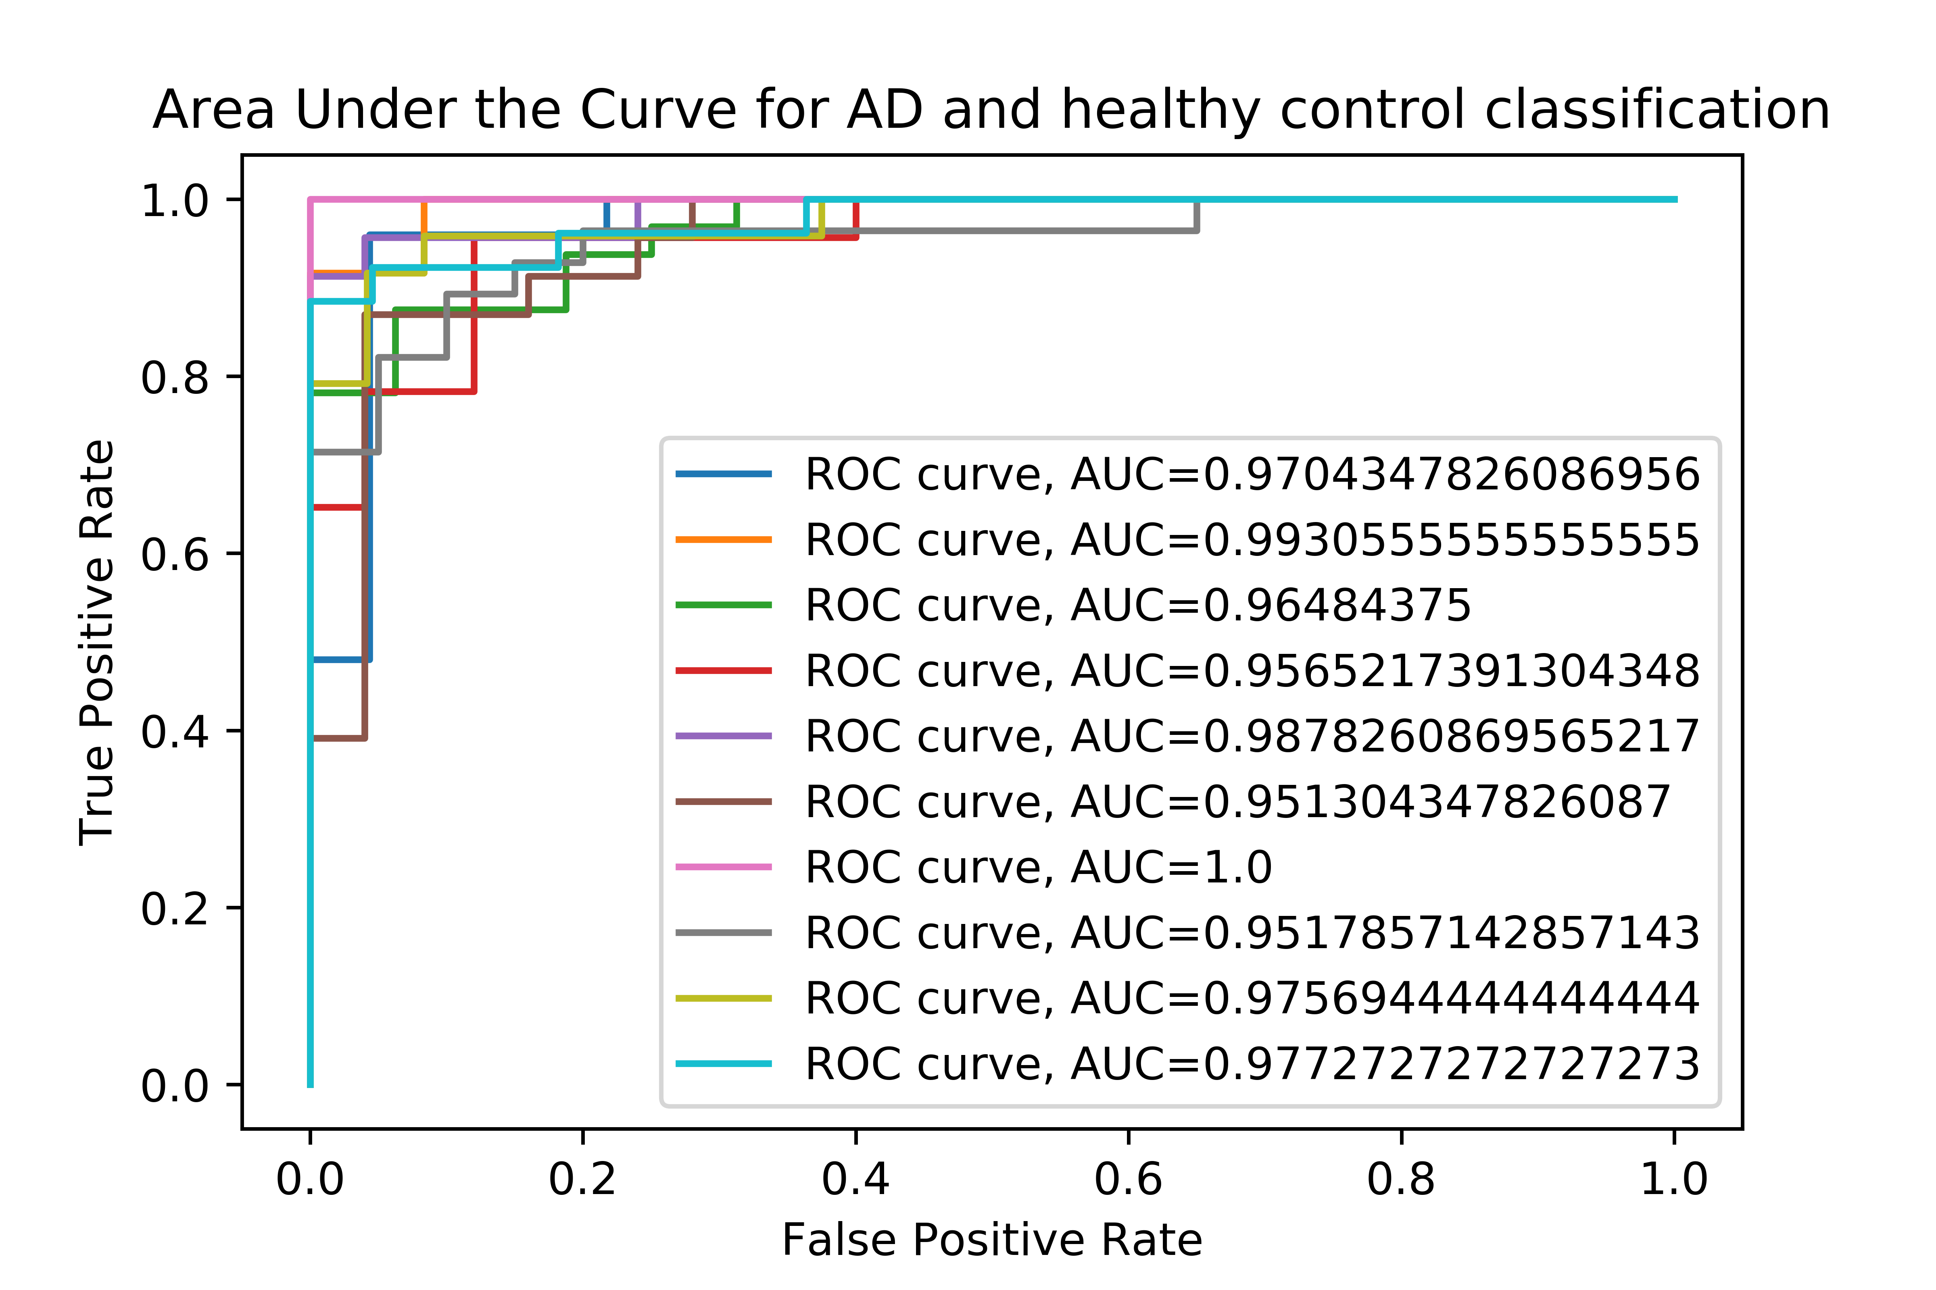
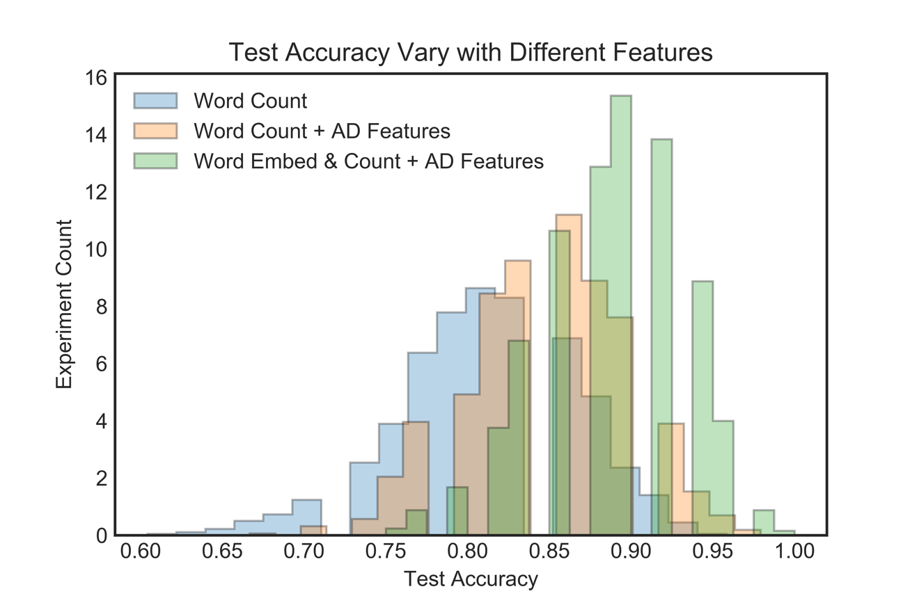
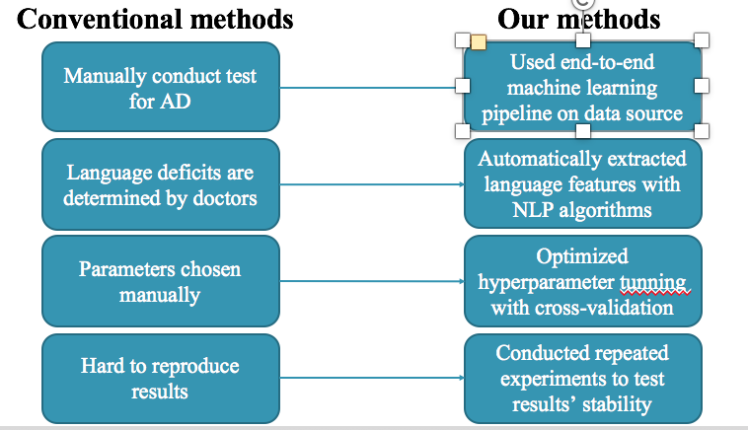
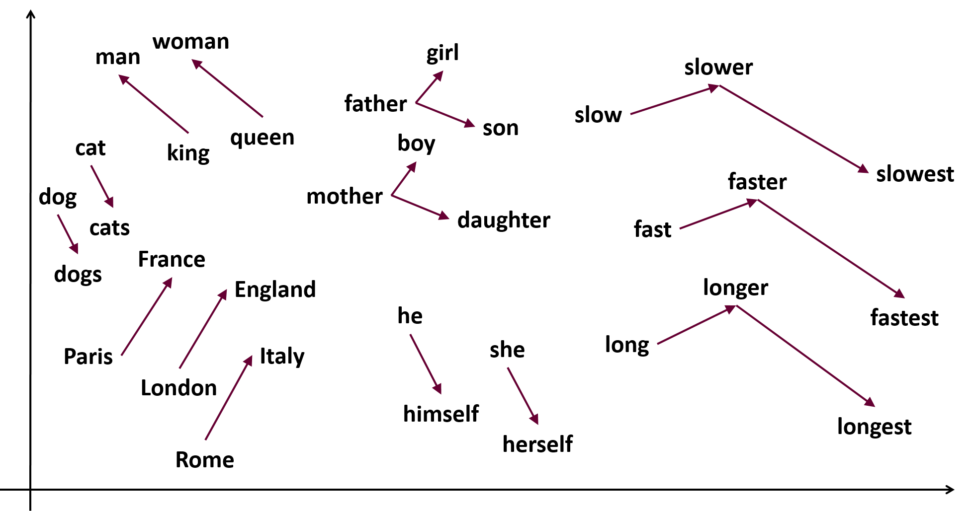
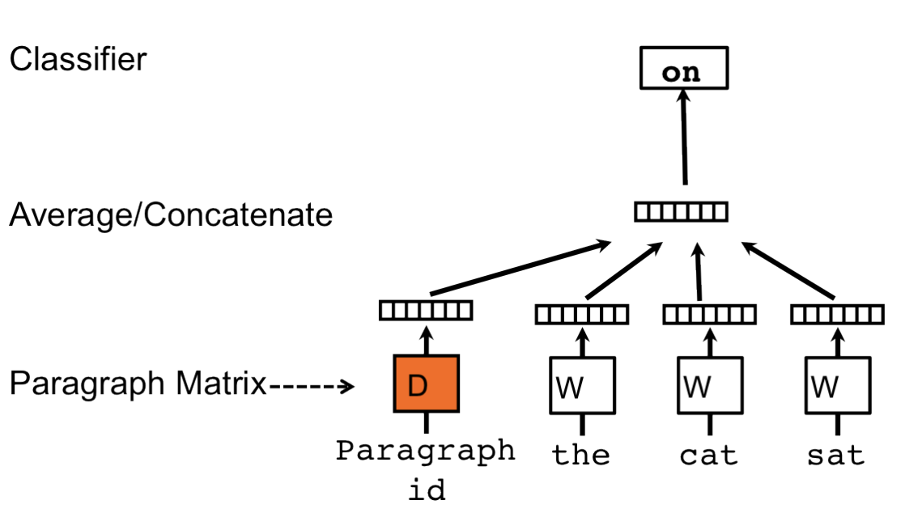
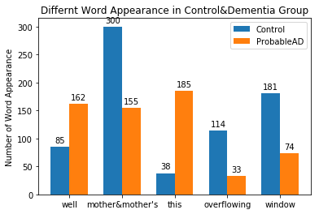
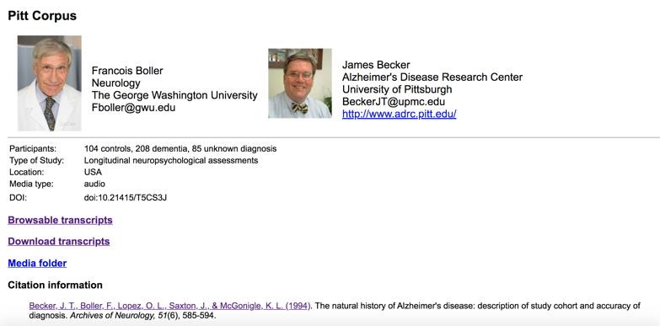
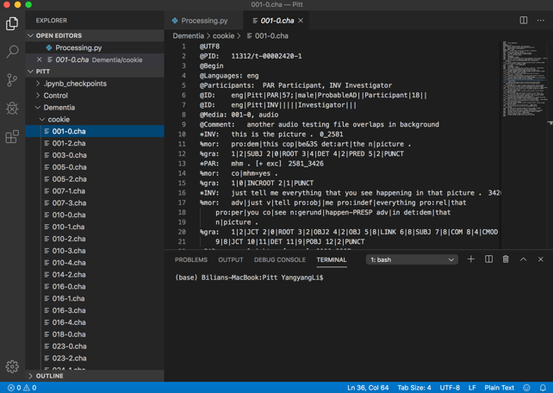
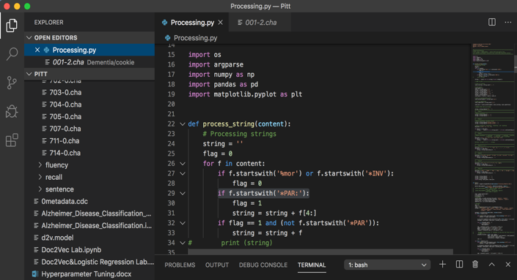
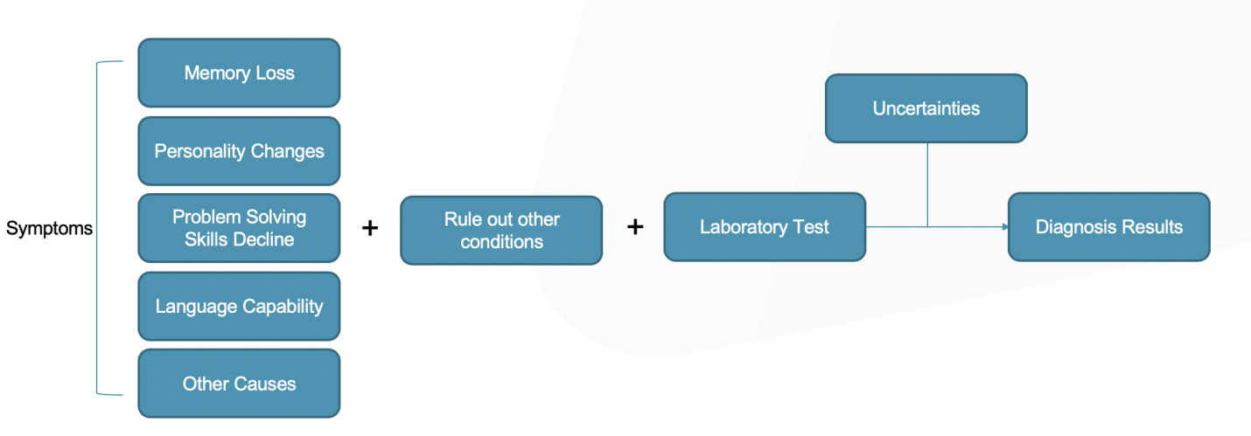
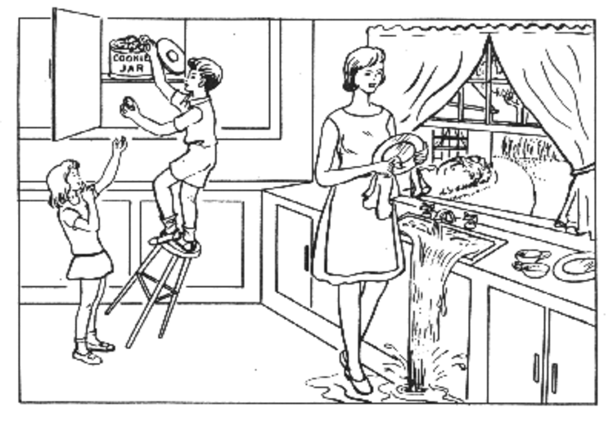
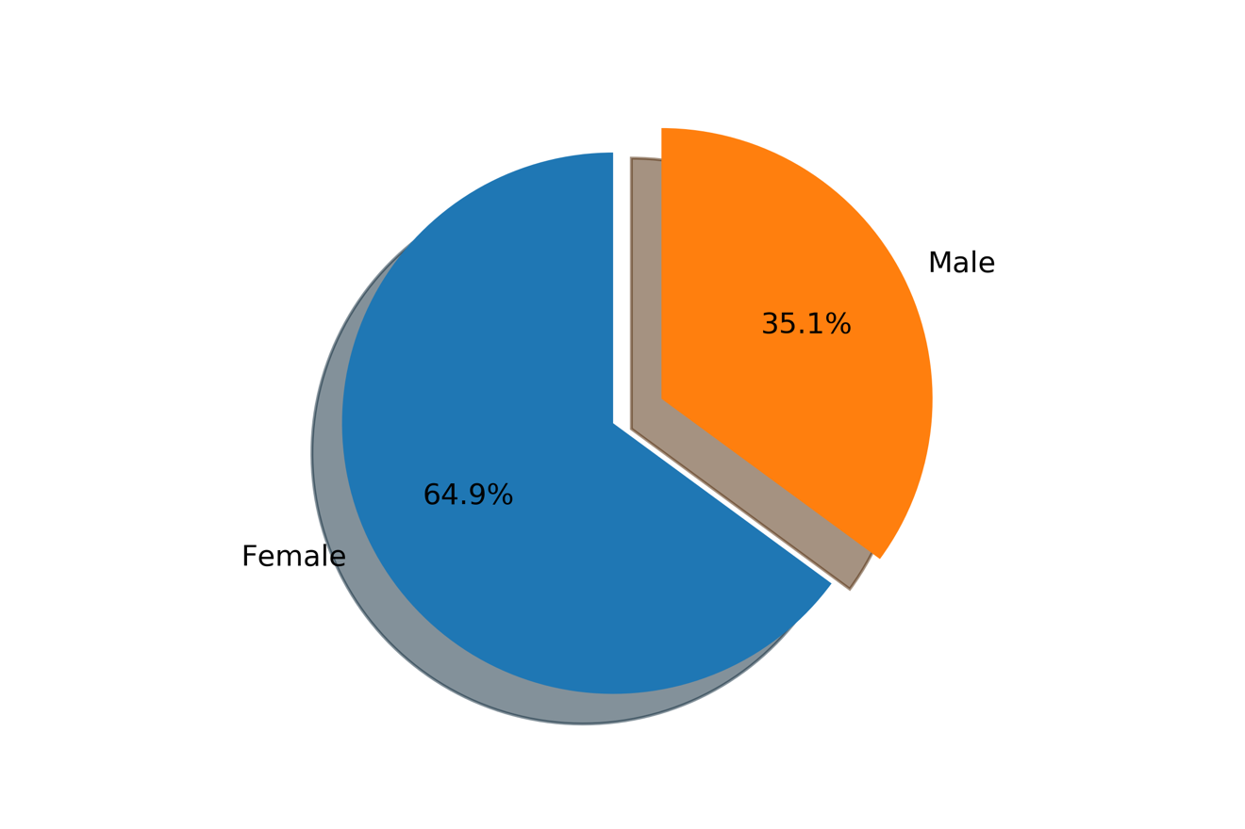
Natural Language Processing and Machine Learning
for Early Diagnosis of Alzheimer's Disease
Yangyang Li
Introduction
Methods
Results
• Alzheimer’s Disease (AD) is the most common form of dementia, and AD can be fatal.
• Early diagnosis is important, but difficult. Several subtypes that clinicians use to further differentiate patients at different stages increases the difficulty of diagnosing accurately.
Logistic regression is a statistical model that uses a logistic function to model a binary dependent variable. It is particularly popular in terms of classifying dichotomous variable, which in our case is whether a patient has AD.
Advantage: Logistic regression is a highly flexible, stable, interpretable, and computationally efficient algorithm. （Cross-validation）
Hyperparameter Optimization
1.Divide data into training/validation/test set;
2. Determine the range of hyperparameter;
3. Search through the hyperparameters and find
the best that gives highest validation accuracy;
4. Train a model with the best hyperparameter;
5. Evaluate the performance of the best model
performance on the test set.
Count Vectorizer
Count Vectorizer is very straight forward, it counts the
number of times a token shows up in the document and uses
this value as its weight.
Doc2Vec
Doc2Vec extends the idea of Word2Vec using unsupervised
learning to learn fixed-length feature representation from
variable-length pieces of texts such as sentences, paragraphs
and documents.
1. Overcomes weaknesses of BOW encoding
(ordering loss and semantics of words);
2. Can achieve superior results as the state-of-the-art
algorithm in terms of performing tasks on sentiment
detection and text classification.
84% accuracy score
Strength:
• With machine learning algorithm, there can be higher accuracy and precision of early diagnosis of AD with less information about the patents given.
Weakness:
• Machine learning algorithm requires large amount of data to achieve high accuracy.
• Large amount of data is typically not available.
Innovations
Figure n. Original Preprocessed .csv Data Read into Notebook (with some missing age and mmse score)
1. Built an end-to-end machine learning pipeline on DementiaBank dataset for AD classification
2. Combined features related to AD and automatic extracted features using NLP algorithms
3. Used word count and word embedding to capture statistical information and syntax meaning of the text data
4. Optimized hyperparameter of the classification algorithm using cross-validation (divided data into training, test, and validation sets)
5. Evaluated stability of the classification model by repeated experiments
Figure n. Processed Data Table with Missing Age Filled in with Average + Count Vectorizer Features
Figure 3. Word2Vec
Figure 4. Doc2Vec
Figure 5. Cross-validation
Figure 8. Diagnosis Procedure with Machine Learning
Workflow
Conclusions
In this study, we use machine learning algorithm combined with Natural Language Processing tools, i.e. word embeddings, to distinguish between healthy people and AD patients.
Linguistic features are incorporated into logistic regression to help make better classification.
Accuracy of 84% is achieved, and higher AUC is obtained compared with other studies.
With the new algorithm, AD early diagnosis can become simpler and cheaper with audio data provided remotely by the patients.
The algorithm may become more robust with more available data in the future.
Figure 1. Medical Evaluation Procedure for AD
An important factor to determine whether a patient has AD
Hypothesis
Dataset
• Since language deficit is one of the most important symptom, combining the fact that NLP’s development has been exceptional with deep learning’s application.
• We propose to use NLP algorithm to retrieve information from patients’ interview data, and to further predict how likely the patients have AD. We use feature engineering and NLP algorithms Logistic Regression and Doc2Vec combined to produce a model with high accuracy yielded.
Cross-validation is used to select hyperparameter:
• Every time a validation set is held out to mimic how test error would be. Validation set is chosen randomly every time with volume equal to 1/10 of total data volume. Grid-search the hyperparameter set in the hyperparameter space.
• C Value is inverse of strength of regularization. The optimal C value is chosen such that validation accuracy is highest. Too large / small of regularization strength may cause overfitting / underfitting.
Figure 1. Boston Cookie Theft picture for diagnosing AD
References
National Institute of Aging. (2019, May 22). Alzheimer's Disease Fact Sheet. Retrieved Feb 15, 2020 from https://www.nia.nih.gov/health/alzheimers-disease-fact-sheet
A. L. Goldstein, Biomedical advances in aging. New York: Plenum Press, 1990, pp. 51-62
UsAgainstAlzheimer’s. (2020) Alzheimer’s Crisis. Retrieved February 15 2020 from https://www.usagainstalzheimers.org/learn/alzheimers-crisis
Mayo Clinic. (2019, April 19). Diagnosing Alzheimer's: How Alzheimer's is diagnosed. Retrieved February 15, 2020 from https://www.mayoclinic.org/diseases-conditions/alzheimers-disease/in-depth/alzheimers/art-20048075
Forbes-McKay, K.E., Venneri, A. Detecting subtle spontaneous language decline in early Alzheimer’s disease with a picture description task. Neurol Sci 26, 243–254 (2005). https://doi.org/10.1007/s10072-005-0467-9
Boston Medical Center. (2019, March 18). Study finds test of protein levels in the eye a potential predictor of (future) Alzheimer's disease. ScienceDaily. Retrieved February 14, 2020 from www.sciencedaily.com/releases/2019/03/190318151724.htm
Mitchell AJ. A meta-analysis of the accuracy of the Mini-Mental State Examination in the detection of dementia and Mild Cognitive Impairment. J Psychiatr Res. 2009;43(4):411–31
Francois Boller and James Becker. 2005. Dementiabank database guide. University of Pittsburgh.
Kleinbaum, D. G., Dietz, K., Gail, M., Klein, M., & Klein, M. (2002). Logistic regression. New York: Springer-Verlag.
Xing, C., Wang, D., Liu, C., & Lin, Y. (2015). Normalized word embedding and orthogonal transform for bilingual word translation. In Proceedings of the 2015 Conference of the North

